Slide 1

E-commerce Store Analysis
SQL PROJECT

Slide 2

Description:-
Have a Brazilian e-commerce store data over the 3 years period of time .I visualize the data and complete a analysis by using the MySQL server to complete this analysis.

Slide 3
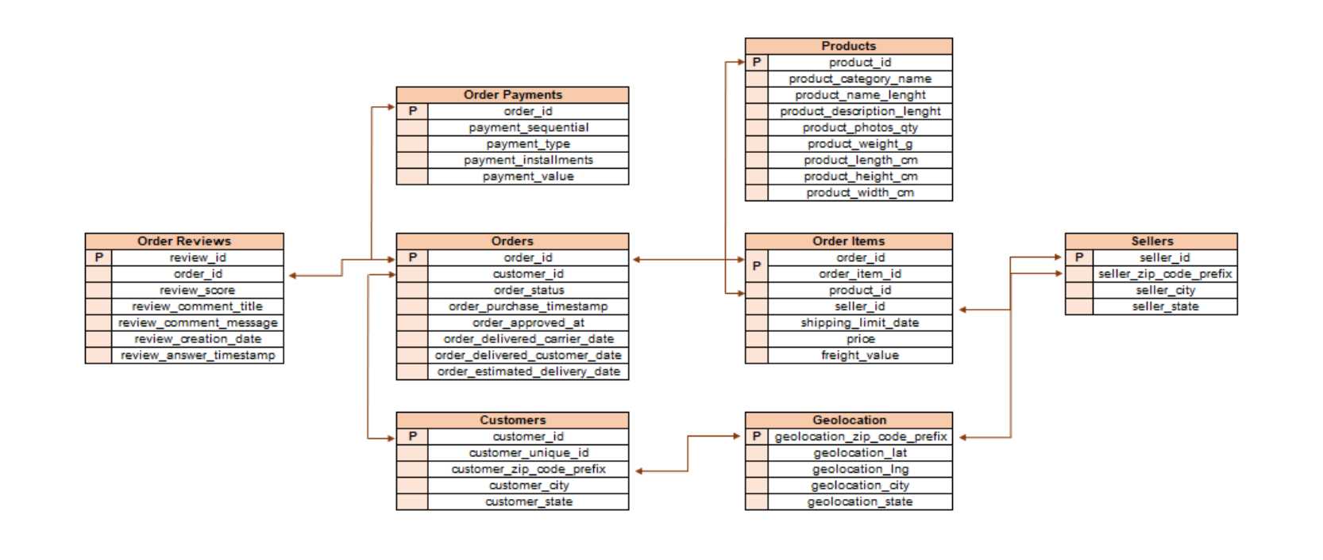
E-commerce Store Database Schema

Slide 4

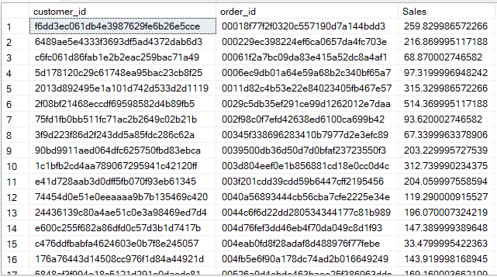
QUESTION 1:-
Write a Query to find out the Total Sales of order.
It Shows the Total sales as per order id.

Slide 5
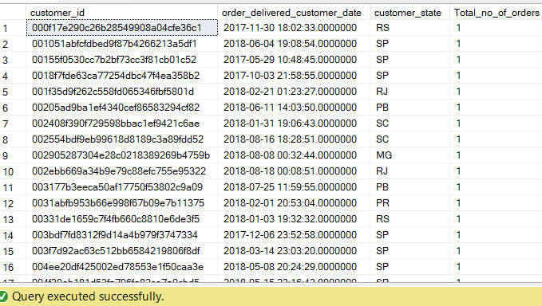
QUESTION 2:-
Write a Query to show the Orders according to their State.
It Shows the Total orders of customers as per state.

Slide 6


QUESTION 3:-
Write a Query to show top 2 States which declining the trend over the years and increasing the trend over the years.
It Shows the Top 2 states by declining the trend over the years
It Shows the Top 2 state by Increasing the trend over the years.

Slide 7
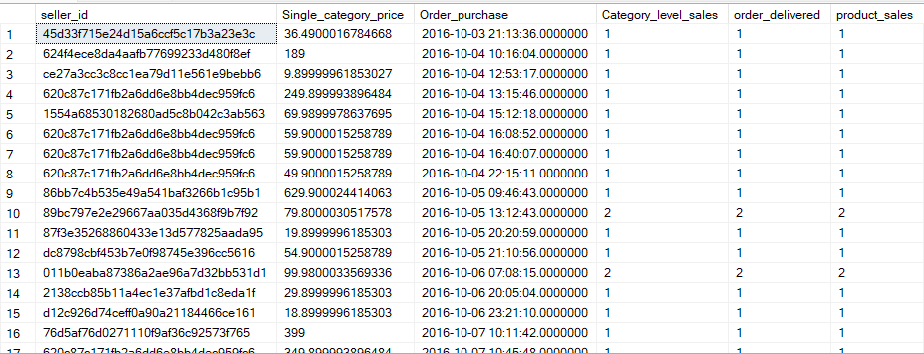
QUESTION 4:-
Write a Query to show the order delivered by the sellers.
It Represents the number of orders is delivered by the seller as per the order purchase.

Slide 8


QUESTION 5:-
Write a Query to show the percentage of orders is delivered before the actual date and time and delivered after the actual date and time.
It Shows the % of the orders is delivered before the actual Date and Time.
It Shows the % of the orders is delivered after the actual Date and Time.

Slide 9


QUESTION 6:-
Write a Query to show top 2 Cities which declining the trend over the years and increasing the trend over the years.
It Shows the Top 2 Cities by declining the trend over the years
It Shows the Top 2 Cities by Increasing the trend over the years.

Slide 10




THANK YOU!
Harsh Sahu
harshsahu.gs369@gmail.com
7987608240

